Slide 1
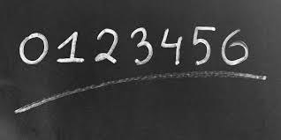
Digit Classification using Support Vector Machines (SVM)
DATA 602 Intro to Data Analysis and Machine Learning
Spring 2023
Leela Manikanta Cheekatla - JX33255
Varun Balle - QL24695

Slide 2
Table of contents
Problem Statement
Dataset Description
Digit Classification
Support Vector Machine
K- Nearest Neighbors
GridSearchCV
Confusion Matrix
Classification Report
Results

Slide 3
Problem Statement
The objective is to identify each of a large set of binary images as one of the digits from 0 to 9.
Each character has 200 instances (a total of 2000 instances) and each sample is described with 298 attributes
Unlike traditional digit classification we are not taking pixels as features, but we have designated attributes.
Given attributes are:
mfeat-fou: 76 Fourier coefficients of the character shapes;
mfeat-fac: 216 profile correlations;
mfeat-mor: 6 morphological features

Slide 4
Dataset Description
The data is loaded from the given git repository link to our notebook.
The dataset used in the code above is the "Mfeat" dataset, which contains features extracted from binary images of handwritten digits.
Number of samples: 2000
Number of classes: 10 (digits 0-9)
Number of instances per class: 200
Number of features per instance: 298

Slide 5
Digit Classification
Digit classification is a type of image recognition task that involves identifying handwritten digits in images. The objective of digit classification is to correctly identify the digit represented by each image.
It is an important task in many fields, including computer vision, robotics, and automation.
It has many applications, such as recognizing handwritten digits on checks or forms, recognizing digits in street addresses for navigation systems, and more.

Slide 6
Support Vector Machine
Support Vector Machines (SVMs) are a type of supervised learning algorithm used for classification and regression analysis.
SVMs work by finding the optimal boundary (hyperplane) between two classes of data points in a feature space.
SVMs use a linear kernel to find the hyperplane that separates the data.
SVMs are known for their ability to handle high-dimensional data, which makes them suitable for many real-world applications such as image recognition, text classification, and bioinformatics.
Notes:
Why did you use SVM?
SVMs are also less prone to overfitting than other classification algorithms, and they have a solid theoretical foundation in optimization theory.
What is overfitting?
When the model is trained to fit the training data too closely, resulting in poor performance on new and unseen data.
Causes of Overfitting?
Overfitting can be caused by several factors, including:
A model that is too complex or has too many parameters relative to the amount of training data.
A dataset that contains noise or irrelevant features.
Insufficient regularization, which allows the model to fit the noise or random fluctuations in the data.
Training a model for too long, which can cause it to overfit the training data.
Why SVM Linear
In the case of digit classification, the features used to describe the images were extracted using Fourier coefficients, profile correlations, and morphological features. These features may be linearly separable, which would make a linear kernel a good choice for the SVM classifier.
What is Confusion Matrix?
It shows the number of true positive (TP), true negative (TN), false positive (FP), and false negative (FN) predictions made by the model on a set of test data.

Slide 7
K- Nearest Neighbors
KNN (k-Nearest Neighbors) is a supervised machine learning algorithm used for classification and regression tasks.
The algorithm works by finding the k nearest training data points to a new data point based on some similarity metric (usually Euclidean distance) and assigns the label of the majority class among these k neighbors as the predicted label for the new point.
The performance of the model is evaluated by comparing the predicted class labels to the true class labels in the test dataset.
Notes:
In KNN, the algorithm calculates the distance between a new data point and all other data points in the training set. The K closest data points (i.e., neighbors) are then selected based on this distance metric, and the new data point is classified or predicted based on the class or value of the majority of these nearest neighbors.

Slide 8
Grid Search CV
The process involves creating a grid of possible hyperparameter values and evaluating the model's performance using cross-validation on each combination of hyperparameters in the grid.
GridSearchCV is implemented in various machine learning libraries, such as scikit-learn, TensorFlow, and Keras. In scikit-learn.
The GridSearchCV class automatically splits the data into training and validation sets using cross-validation and trains the model using the training set for each combination of hyperparameters in the grid.
Notes:
Grid search cross-validation is a way to help us find the best settings by trying out different combinations of settings and testing each combination on a subset of the data. It does this by creating a "grid" of different settings that we want to test, and then evaluating the model's performance for each combination of settings using a method called cross-validation.
Cross-validation involves splitting the data into multiple subsets, training the model on some of the subsets, and testing it on the remaining subset. By doing this multiple times and averaging the results, we can get a good estimate of how well the model will perform on new data.
Grid search cross-validation tries out all possible combinations of settings in the grid, and returns the combination that performs the best on average across all of the cross-validation runs.

Slide 9
Confusion Matrix
A confusion matrix is a table that is often used to evaluate the performance of a classification model. It shows the number of true positive (TP), true negative (TN), false positive (FP), and false negative (FN) predictions made by the model on a set of test data.
 | Predicted Negative | Predicted Positive
Actual Negative | True Negative (TN) | False Positive (FP)
Actual Positive | False Negative (FN) | True Positive (TP)
Notes:
True Positive (TP): the model predicted the positive class, and the actual class is positive.
True Negative (TN): the model predicted the negative class, and the actual class is negative.
False Positive (FP): the model predicted the positive class, but the actual class is negative.
False Negative (FN): the model predicted the negative class, but the actual class is positive.

Slide 10
Classification Report
The classification report is a useful tool for evaluating the performance of a classification model. It provides a summary of key performance metrics for each class in the dataset, as well as overall metrics that can be used to evaluate the overall performance of the model.
Precision: the proportion of predicted positive cases that were positive
Recall: the proportion of actual positive cases that were correctly identified as positive
F1 score: the harmonic mean of precision and recall, providing a balance between the two metrics
Support: the number of observations in each class

Slide 11
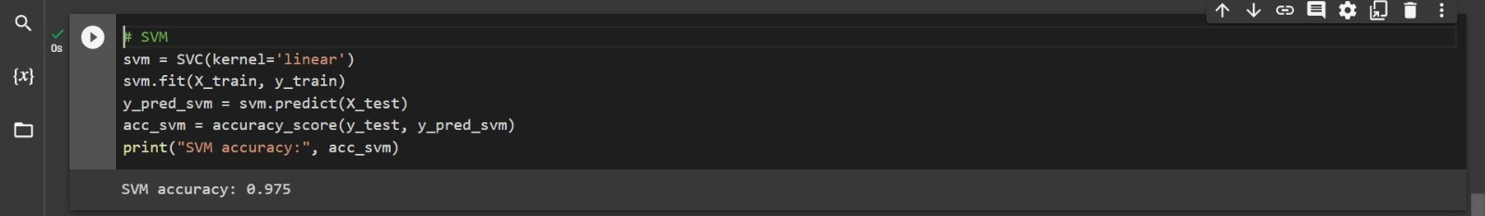
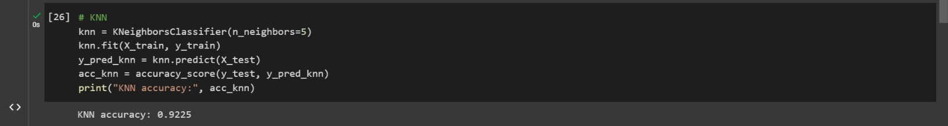
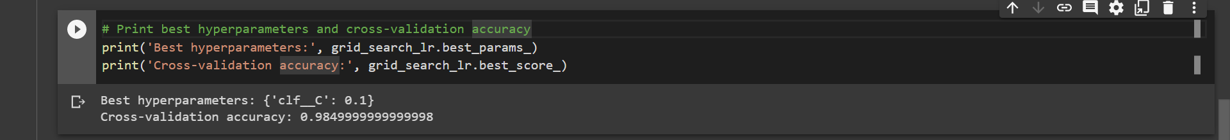
Results
Accuracy with SVM
Accuracy with KNN
Accuracy with GridSearchCV

Slide 12
Results
The SVM model performed better than the KNN model for the digit classification task. The SVM model achieved an accuracy score of 0.975, while the KNN model achieved an accuracy score of 0.9225.
But when compared to both SVM and KNN, GridSearcgCV was able to

Slide 13
References
[1] Brownlee, J. (2019, May 7). How to Develop a CNN for MNIST Handwritten Digit Classification. Machine Learning Mastery. https://machinelearningmastery.com/how-to-develop-a-convolutional-neural-network-from-scratch-for-mnist-handwritten-digit-classification/
[2]Gandhi, R. (2018, June 7). Support Vector Machine — Introduction to Machine Learning Algorithms. Towards Data Science. https://towardsdatascience.com/support-vector-machine-introduction-to-machine-learning-algorithms-934a444fca47
[3]Harrison, O. (2018, September 10). Machine Learning Basics with the K-Nearest Neighbors Algorithm. Medium; Towards Data Science. https://towardsdatascience.com/machine-learning-basics-with-the-k-nearest-neighbors-algorithm-6a6e71d01761
[4]Narkhede, S. (2018, May 9). Understanding Confusion Matrix. Medium; Towards Data Science. https://towardsdatascience.com/understanding-confusion-matrix-a9ad42dcfd62

